Slide 1
Structure of DNA

Slide 2
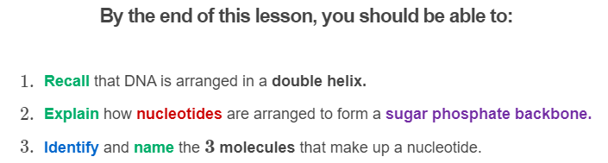
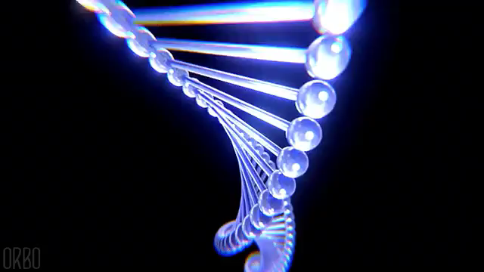

Slide 3
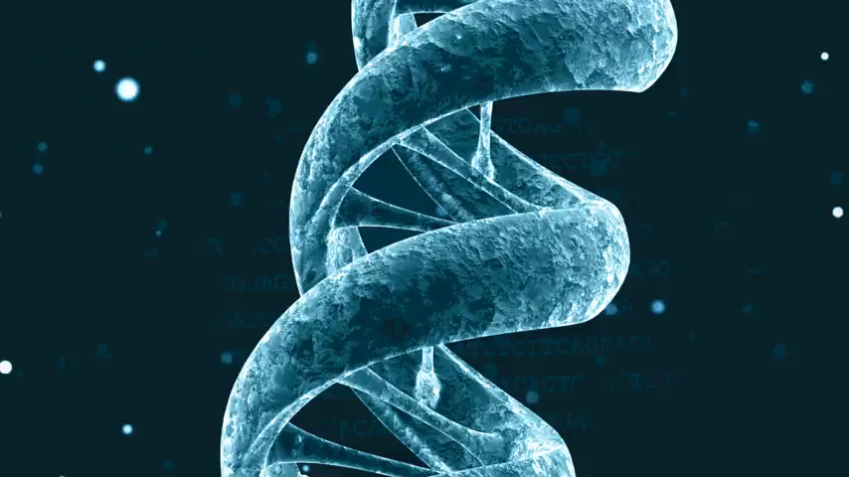
Like yarn, when viewed up close DNA has a spiralling structure.
This structure is called a double helix.

Slide 4
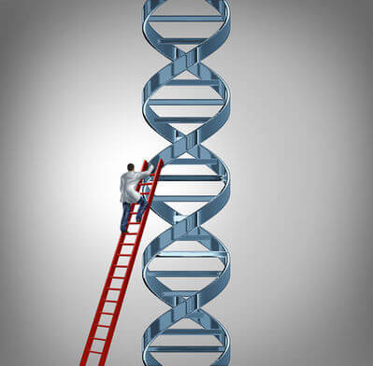
The double helix was discovered in 1953 by James Watson and Francis Crick.
Critical to their discovery was an X-ray crystallography photo taken by Rosalind Franklin.
X-ray crystallography can produce images of large molecules such as DNA.

Slide 5
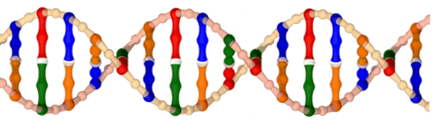
The helix resembles a twisted rope ladder.
It contains two long, spiralling strands called sugar phosphate backbones.
These are the peach coloured strands in the picture below, and resemble the rope of the ladder.

Slide 6
Nitrogenous bases extend from each sugar phosphate backbone, making the ladder steps.
These are the colourful bars in the below picture.

Slide 7
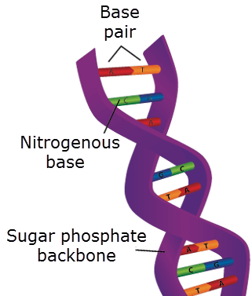
Nitrogenous bases from one backbone bind to nitrogenous bases from the other backbone.
Two nitrogenous bases make a base pair.

Slide 8
DNA structure can seem quite complex at first.

Slide 9
In summary:
Two nitrogenous bases form a bond between the 2 DNA strands. These bonded bases make a base pair.
The spiralling shape of DNA is called a double helix. The helix is made of two things:
1. | Two spiralling sugar phosphate backbones.
2. | Several perpendicular nitrogenous bases

Slide 10
So far we know that the DNA is in the shape of a double helix.
The double helix is made of two sugar phosphate backbones and several nitrogenous bases.
Now we are going to look a little closer at the structure of DNA.

Slide 11
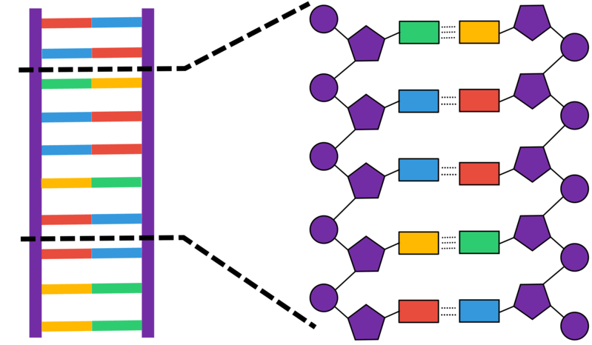
Here is a short piece of DNA, depicted in greater detail:
It looks a bit different from the pictures we have seen so far because it is unwound from the double helix, like untwisting a rope ladder and laying it flat on the ground.

Slide 12
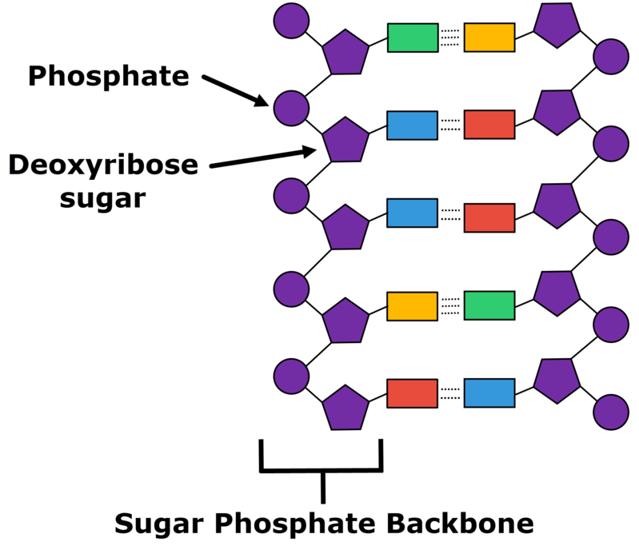
When we look closely, we can see that the sugar phosphate backbone it is made of two repeating units: deoxyribose sugar and phosphate groups.
Phosphate groups can also be called phosphates.

Slide 13
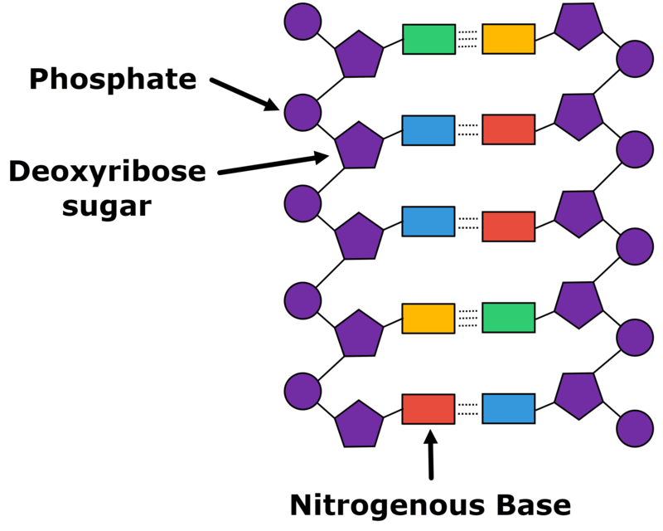
The nitrogenous bases are bound to the deoxyribose sugar.

Slide 14
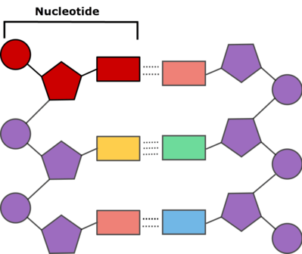
One phosphate, one deoxyribose sugar and one nitrogenous base are together called a nucleotide.

Slide 15
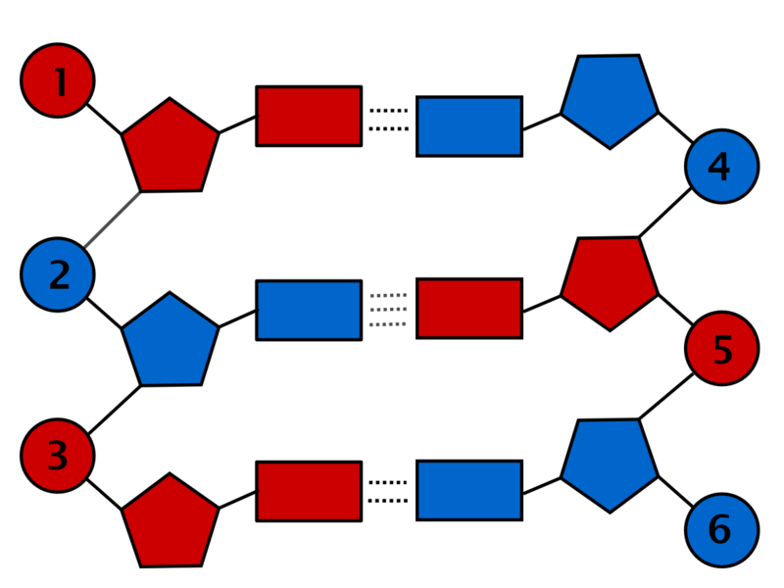
DNA is made up of repeating nucleotides.
This makes nucleotides the basic building blocks of DNA.
In this picture there are six nucleotides: three on each side of the DNA strand. These bonded nucleotides are called base pairs.

Slide 16
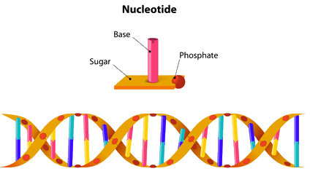
In summary:
• | The sugar phosphate backbone is made from deoxyribose sugar and phosphates.
• | Nitrogenous bases are bound to the deoxyribose sugar.
• | A nucleotide is made from one sugar, one phosphate and one nitrogenous base.

